Slide 1
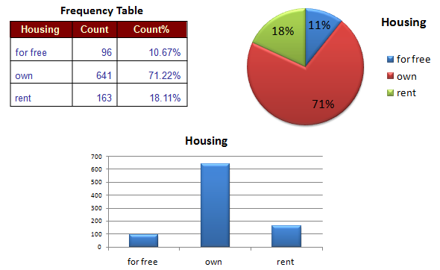
Chapter 2
Displaying and Describing Categorical Data

Slide 2
Three Rules of Data Analysis
Make a picture - things may be revealed that are not obvious in the raw data - things to think about.
Make a picture - important features and patterns in the data will show up. You may also see things that you did not expect.
Make a picture - the best way to tell others about your data is with a well-chosen picture.

Slide 3
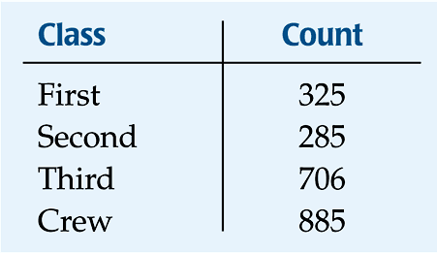
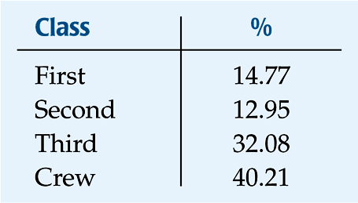
Frequency Tables
For categorical variables, we often compile data by counting the number of values in each category and display these counts in a frequency table:
A relative frequency table is similar, but shows percentages instead of counts.
How ???

Slide 4
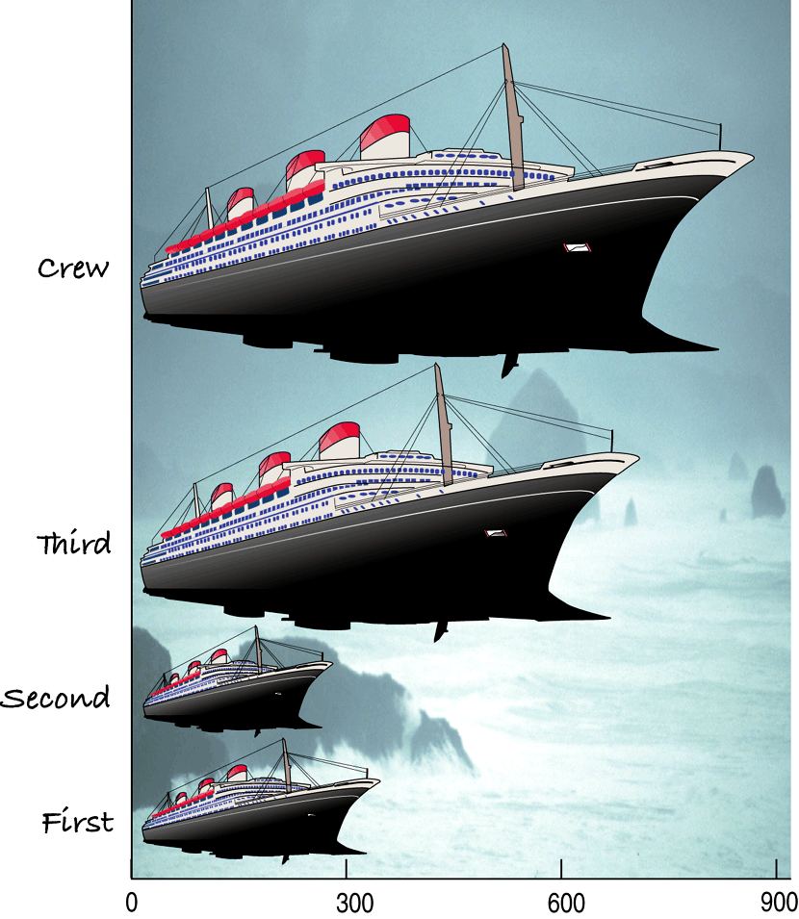
What’s Wrong With This Picture?
You might think that
a good way to show
the Titanic data is
with this display:

Slide 5
The Area Principle
The ship display violates the area principle.
The ship display makes it look like most of the people on the Titanic were crew members, with a few passengers along for the ride.
When we look at each ship, we see the area taken up by the ship, instead of the length of the ship.

Slide 6
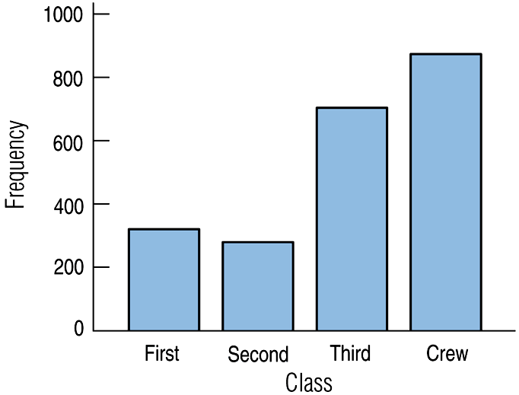
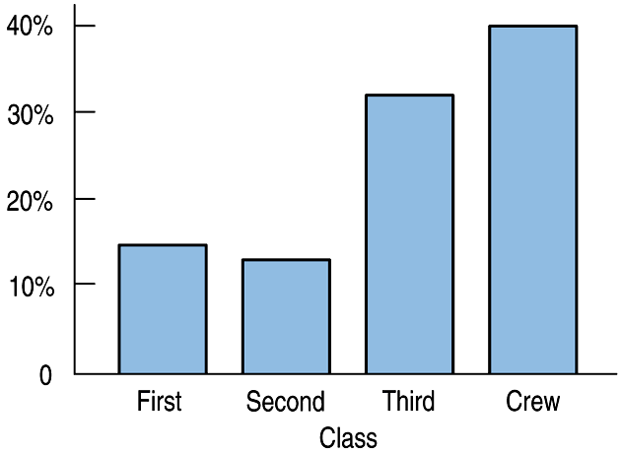
Bar Charts
Bar charts display the distribution of a categorical variables, showing the counts side-by-side.
Relative frequency bar charts display the percentages of counts.
Which do you prefer? Why?

Slide 7
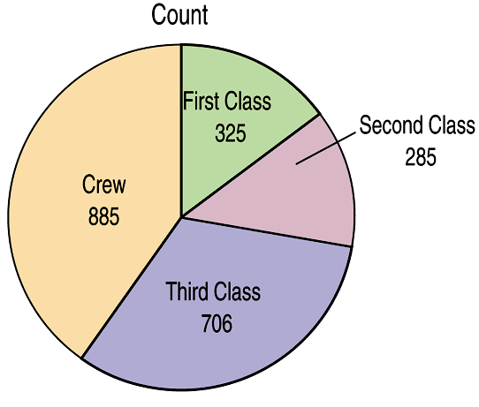
Pie Charts
When you want to display parts of a whole, you can use a pie chart. Pie charts display the counts or percentages.

Slide 8
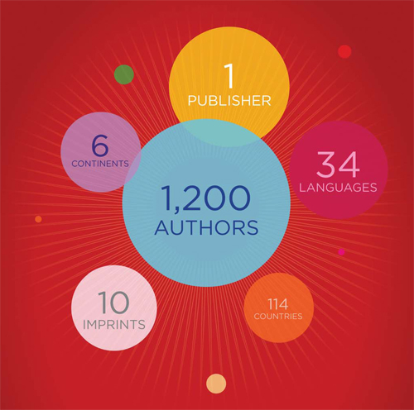
Examples of some violations of the Area Principle: Tell me what is wrong!

Slide 9
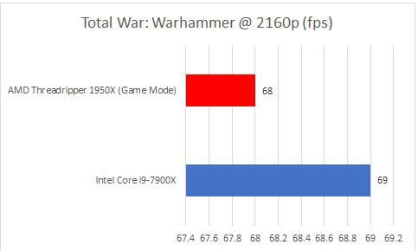
Examples of some violations of the Area Principle: Tell me what is wrong!

Slide 10
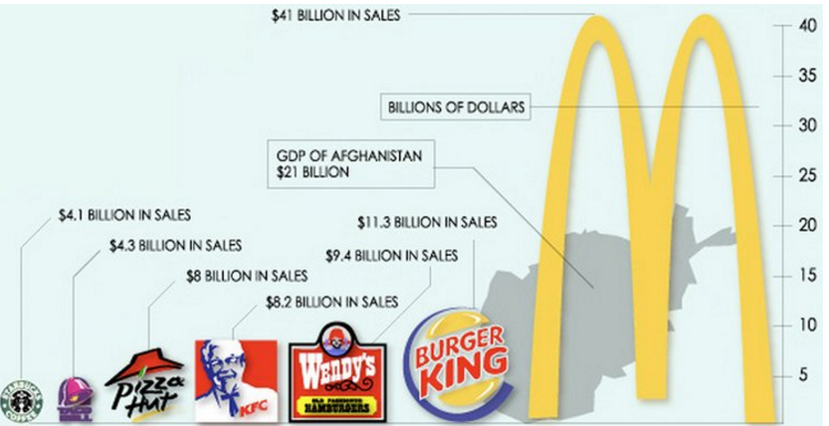
Examples of some violations of the Area Principle: Tell me what is wrong!

Slide 11
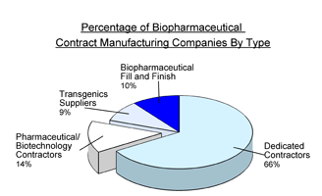
Examples of some violations of the Area Principle: Tell me what is wrong!

Slide 12
Classwork:
Find a graph on the internet that is an example of a violation of the area principle.
Explain how the graph is misleading and what should be changed to improve it.
Create a new graphical display of the data that does not violate the area principle. For example, you can create a well-drawn bar graph or pie chart.
We will share these with the class.

Slide 13
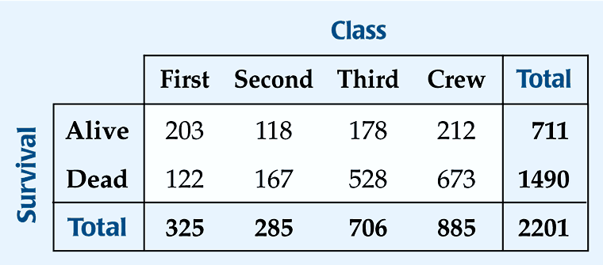
Contingency Tables…
Allow us to look at two categorical variables at the same time.
Show how individuals are distributed across each variable, contingent on the second variable.
What two variables are we looking at here??

Slide 14
Contingency Tables (cont.)
The margins (right and bottom) of a contingency table should have row and column totals (ADD THEM). We use these totals to calculate marginal distributions.
Example:
The marginal distribution of Alive is:
Find the marginal distribution of Second Class:
711
/2201 = 32%
285/2201 (13%)

Slide 15
Contingency Tables (cont.)
Each cell of the table gives a count for a combination of variables.
This cell tells us that 673 crew members died when the Titanic sunk.

Slide 16
Conditional Distributions
A conditional distribution shows the distribution of one variable for just the individuals who satisfy some condition on another variable.
The following is the conditional distribution of ticket Class, conditional on being Alive:

Slide 17
Conditional Distributions (cont.)
The following is the conditional distribution of ticket Class, conditional on being Dead:

Slide 18
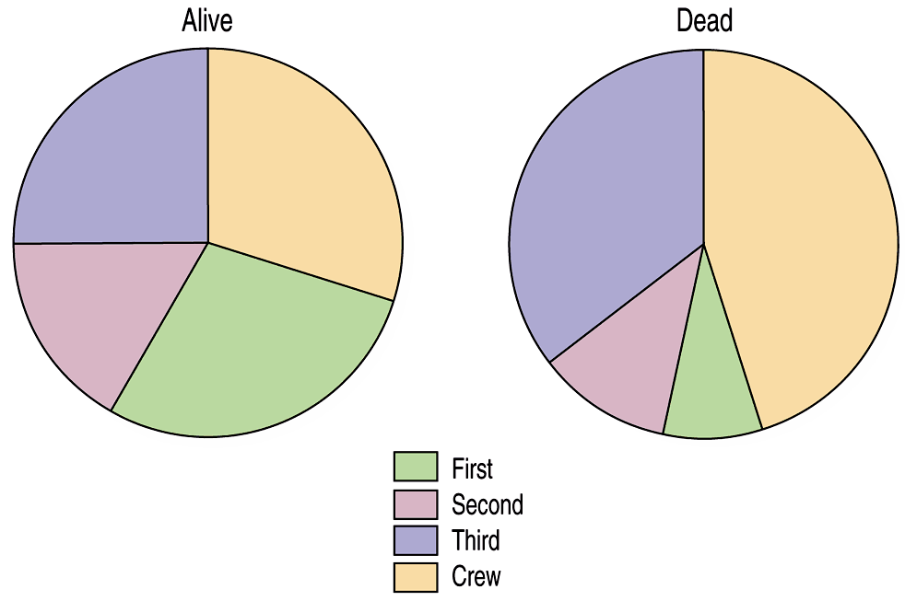
Conditional Distributions (cont.)
Is there a difference in class for those who survived and those who perished?
This is better shown with pie charts of the two distributions:

Slide 19
Conditional Distributions (cont.)
Is the distribution of Class for the survivors different from that of the non-survivors?
Do you think that Class and Survival are associated?
So is Class and Survival independent of each other?
The variables are considered independent when the distribution of one variable is the same for all categories of the other variable.

Slide 20
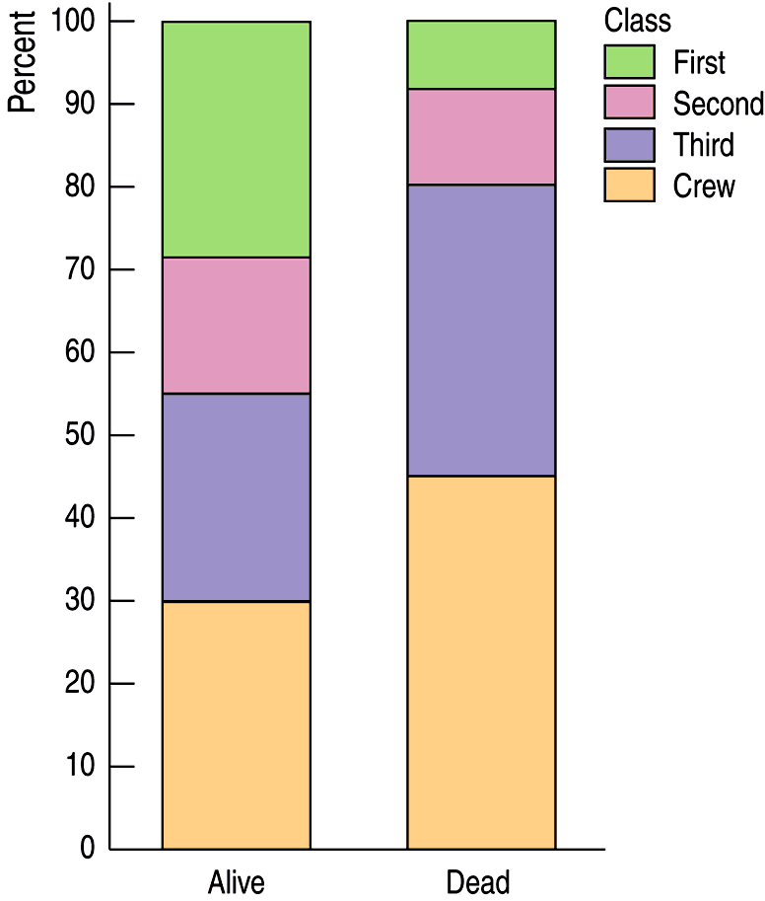
Segmented Bar Charts
A segmented bar chart displays the same information as a pie chart, but in the form of bars instead of circles.
Each bar is treated as the “whole” and is divided into segments corresponding to the percentage in each group.
Here is the segmented bar chart for ticket Class by Survival status:

Slide 21
Classwork:
Chapter 2 Example Problems

Slide 22
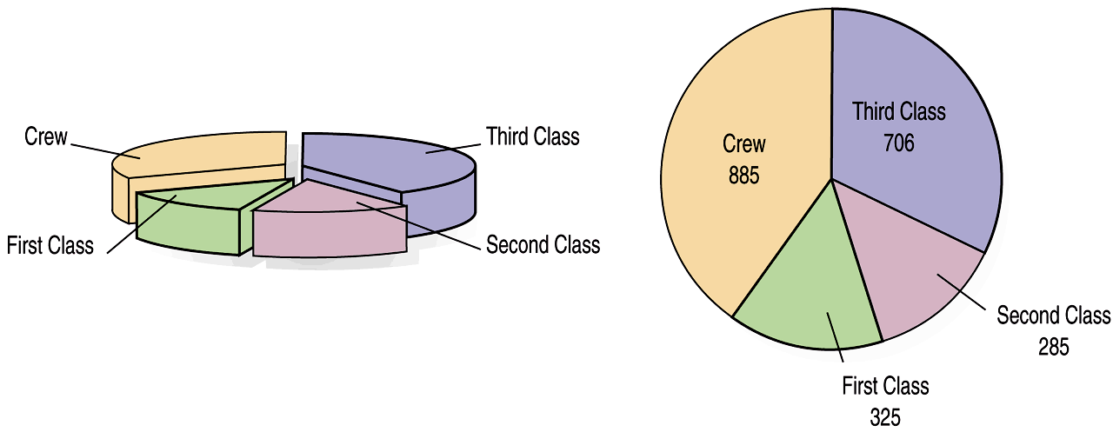
What Can Go Wrong?
Don’t violate the area principle.
Some people might like the pie chart on the left, but it violates the area principal.

Slide 23
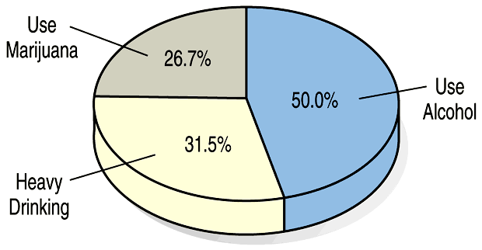
What Can Go Wrong? (cont.)
Keep it honest—make sure your display shows what it says it shows.
This plot of the percentage of high-school students who engage in specified dangerous behaviors has a problem. Can you see it?

Slide 24
What Can Go Wrong? (cont.)
Be sure to use enough individuals!
Don’t make a report like:
“66.67% of the participants in our drug study had improved health…
… the other one died.”

Slide 25
What have we learned?
We can summarize categorical data by counting the number of cases in each category (expressing these as counts or percents).
We can display the distribution in a bar chart or pie chart.
And, we can examine two-way tables called contingency tables, examining marginal and/or conditional distributions of the variables.

Slide 26
Classwork:
Chapter 2 Test Review

Slide 27
Chapter 2 Test Tomorrow!

