Slide 1
Chapter 4
Understanding and Comparing Distributions

Slide 2
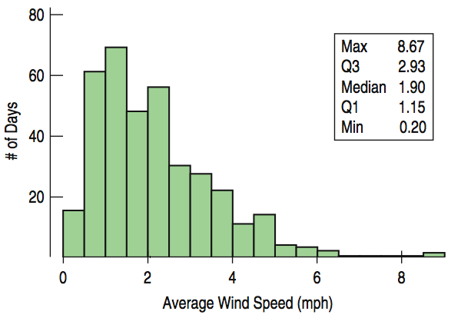
The Big Picture
We can answer interesting questions about variables when we compare distributions for different groups.
Here is a histogram of the Average Wind Speed for each day in 1989.
Where is the mean?

Slide 3
The Big Picture (cont.)
Someone “CUSS”!
Uni-modal and skewed right.
This value may be an outlier.
The median is 1.9 mph; the IQR is 1.78 mph.

Slide 4
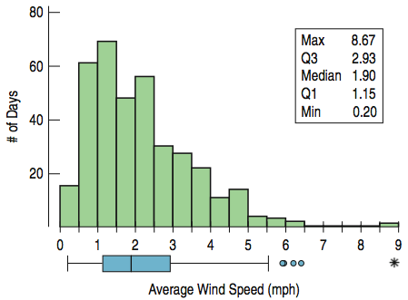
Wind Speed: Making Boxplots (cont.)
Histogram & boxplot for daily wind speeds:
What do we see?

Slide 5
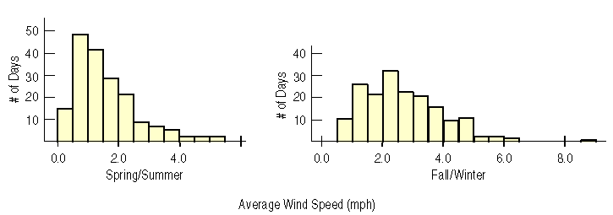
Comparing Groups
Sometimes it is more interesting to compare groups (here: spring/summer & fall/winter).
With histograms, we can note the shapes, centers, and spreads of the two distributions.
Someone compare these distributions (CUSS comparatively)!

Slide 6
Comparing Groups
In the Spring/Summer, the wind speeds are strongly skewed to the right.
The Fall/Winter wind speeds are more uniform, with one outlier.
Are some months windier than others?
Are wind speeds equally variable from month to month?
Do some months show more variation?

Slide 7
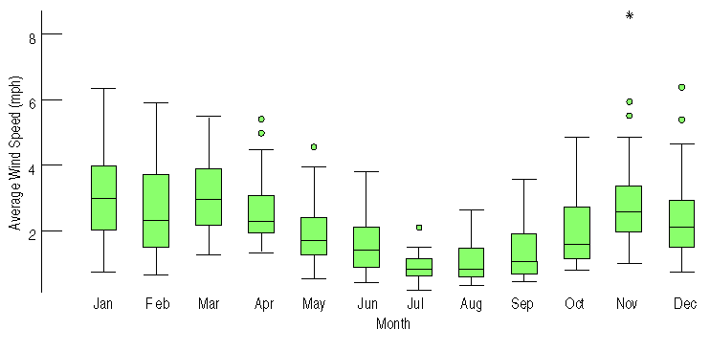
Comparing Groups (cont.)
Boxplots offer a nice balance of information and simplicity, displaying overall summary information.
We can plot them “side-by-side” for groups or categories that we wish to compare (in this case, by month).
What do we see?

Slide 8
Comparing Groups (cont.)
Why do we now see outliers?
Because they are relative to the month.
Example: A windy day in July wouldn’t stand out in November.

Slide 9
Comparing Groups (cont.)
When do wind speeds tend to decrease?
In the summer.
When are winds the strongest and most variable?
From November to April.

Slide 10
What About Outliers?
Why do you think there could have been an outlier in November?
Maybe the outlier in November was a rare tornado?
Some research could only tell.

Slide 11
What About Outliers?
If there are clear outliers and you want to report the mean and standard deviation, report them with the outliers present and with the outliers removed. The differences may be quite revealing.

Slide 12
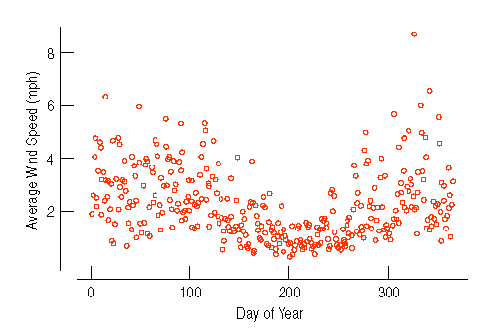
Timeplots
For some data sets, we are interested in how the data behave over time. In these cases, it may be helpful to construct time plots of the data.
Here we are looking at calendar ‘year days’, starting on day 1.
What do we see?

Slide 13
Timeplots: Order, Please!
There are more calm periods in the summer, starting around day 150.
Winds are more variable and stronger during the earlier and later parts of the year.

Slide 14
Classwork:
Comparing Groups Worksheet

Slide 15
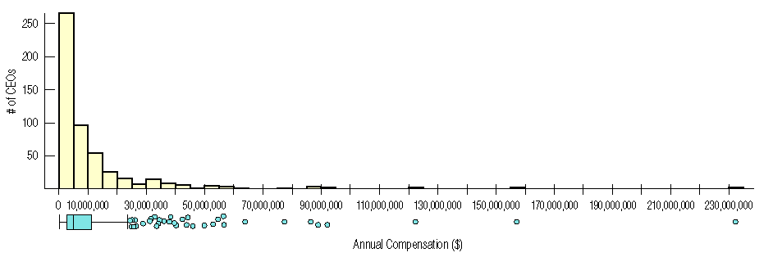
Re-expressing Skewed Data
When data are strongly skewed it can be hard to summarize them using center and spread, and hard to decide whether extreme values are outliers or just part of a stretched out tail.
How can we say anything useful about such data?
What do we see?

Slide 16
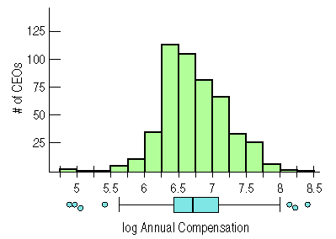
Re-expressing Data
One way to make a skewed distribution more symmetric is to re-express (transform) the data by applying some simple function (example: logarithm).
Note the change in skewness from the raw data (previous slide) to the transformed data (right).
OMG! There’s actually a use for logarithms!!

Slide 17
Here are both…
Re-expression rescales the data; maintaining the relative magnitudes of the individual data points and giving us a better “look” at the distribution.

Slide 18
*Re-expressing Skewed Data to Improve Symmetry (cont.)
We can now see that a typical log compensation is between about 6.5 and 7.
What does this mean?
This corresponds to $3,162,277.66 through $10,000,000.
Do you remember how to do logs?

Slide 19
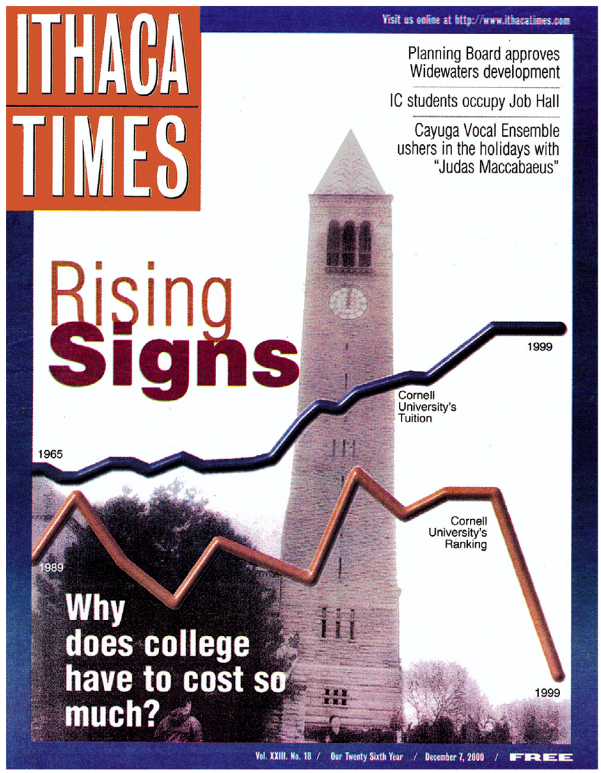
What Can Go Wrong?
Avoid inconsistent scales, either within the display or when comparing two displays.
Label clearly so the reader knows what the plot displays.

Slide 20
Classwork/Homework:
Chapter 4 Review for the Quiz: Understanding and Comparing Distributions
Chapter 4 Quiz Tomorrow

